Slide 1
Title of Presentation
M. Author Institution Name
N. Author Institution Name
2nd Edition of the International Conference On Innovative Materials, Manufacturing, And Advanced Technologies
Sousse, Tunisia | October27-29 , 2022

Slide 2
General Information -Delete this slide once done-
This document is a guideline for all presentations for the IMMAT’2019.
Each presentation will be 15 minutes long, with 5 minutes of questions.
The conference logo and presentation footer must not be removed.
The logo may be resized and repositioned if required.
The presentations must be in a .pptx or .pdf format.
The slides may be customised to the authors desired standards. This may include altering slide background, layout, text, content and any aesthetic properties.
The slide headings within this document are merely suggestions, the author is free to include or alter as they feel necessary.
2nd Edition of the International Conference On Innovative Materials, Manufacturing, And Advanced Technologies
Sousse, Tunisia | October27-29 , 2022

Slide 3
Table of Content
Background.
Etc..
2nd Edition of the International Conference On Innovative Materials, Manufacturing, And Advanced Technologies
Sousse, Tunisia | October27-29 , 2022

Slide 4
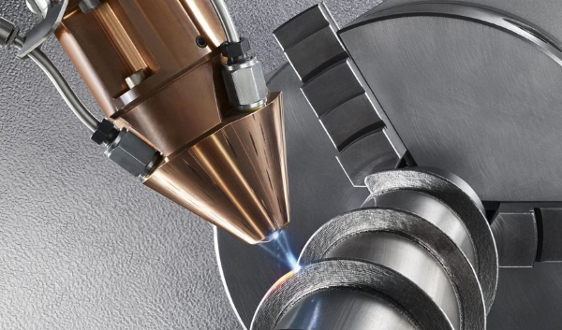
Background
Content related to this research.
Figure 1 – Additive manufacturing
2nd Edition of the International Conference On Innovative Materials, Manufacturing, And Advanced Technologies
Sousse, Tunisia | October27-29 , 2022

Slide 5
Results
Content related to this research.
Table 1 – Table Title Example
Column A | Column B | Column C
2nd Edition of the International Conference On Innovative Materials, Manufacturing, And Advanced Technologies
Sousse, Tunisia | October27-29 , 2022

Slide 6
Conclusions
This slide is to conclude the research that has been presented.
2nd Edition of the International Conference On Innovative Materials, Manufacturing, And Advanced Technologies
Sousse, Tunisia | October27-29 , 2022

Slide 7
Acknowledgements
This slide is to acknowledge all contributing members of this research.
2nd Edition of the International Conference On Innovative Materials, Manufacturing, And Advanced Technologies
Sousse, Tunisia | October27-29 , 2022

